Slide 1
Introduction to Machine Learning – Evaluating Models
Dr. Ab Mosca (they/them)
Slides based off slides courtesy of Jordan Crouser (https://jcrouser.github.io/)

Slide 2
Plan for Today
Evaluating Supervised Machine Learning:
Regression
Classification
Bias-variance trade off
GitHub Classroom

Slide 3
Recap
Supervised Learning
Unsupervised Learning
Find the best function (f) for Y = f(X) + ϵ
Y is the output
X is the input
Our data contains ground truth
i.e. for the values of X in our data, we know Y
Learn patterns from unlabeled data
Our data does not contain ground truth
i.e. we do not know if there are distinct groups in our data

Slide 4
Warm up
Supervised Learning
Unsupervised Learning
Find the best function (f) for Y = f(X) + ϵ
Y is the output
X is the input
Our data contains ground truth
i.e. for the values of X in our data, we know Y
Learn patterns from unlabeled data
Our data does not contain ground truth
i.e. we do not know if there are distinct groups in our data
Practice: Come up with an example of an unsupervised machine learning problem and an example of a supervised machine learning problem.

Slide 5

One model to rule them all…?
Question: why not just teach you the best method first?

Slide 6
Answer: there isn’t one
No single method dominates
One method may prove useful in answering some questions on a given data set
On a related (not identical) dataset or question, another might prevail
Notes:
No single method dominates
On a particular data set, for a particular question, one specific method may work well; on a related but not identical dataset or question, another might be better
Choosing the right approach is arguably the most challenging aspect of doing statistics in practice
So how do we do it?

Slide 7
Measuring “quality of fit” for regression models
Question we often ask: how good is my model?
What we usually mean: how well do my model’s predictions actually match the observations?
How do we choose the right approach?
Notes:
One question we might ask: how well do my model’s predictions actually match the observations?
What we need: a way to measure how close the predicted response is to the true response
Flashback to your stats training: what do we use in regression?

Slide 8
Mean squared error
True response
for the i^{th} observation
We take the average
over all observations
Prediction our model gives
for the i^{th} observation

Slide 9
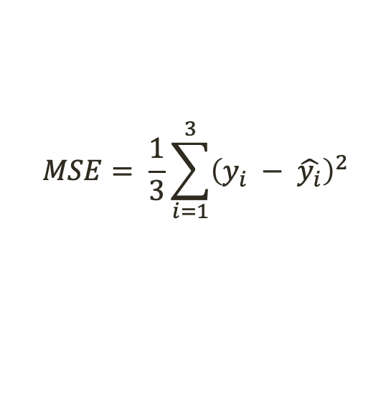

Mean squared error
True response
for the i^{th} observation
We take the average
over all observations
Prediction our model gives
for the i^{th} observation
n = 3
Student | Grade
Ab | 83 | 78
Kaden | 84 | 85
Kylee | 95 | 65
$$MSE= \frac{1}{3}\sum_{i=1}^{3}{{\left(y_{i} − \hat{y_{i}}\right)}^{2}}$$
$$f\left(X\right)$$
$= \frac{1}{3} ({\left(y_{1} − \hat{y_{1}}\right)}^{2}$ + ${\left(y_{2} − \hat{y_{2}}\right)}^{2}$ + ${\left(y_{3} − \hat{y_{3}}\right)}^{2}$)
$= \frac{1}{3} ({\left(83 −78\right)}^{2}$ + ${\left(83 −85\right)}^{2}$ + ${\left(95 −65\right)}^{2}$)
$$=309.67$$

Slide 10
“Training” MSE
This version of MSE is computed using the training data that was used to fit the model
Reality check: is this what we care about?

Slide 11
Test MSE
Better plan: see how well the model does on observations we didn’t train on
Given some never-before-seen examples, we can just calculate the MSE on those using the same method
What if we don’t have any new observations to test?
Can we just use the training MSE?
Why or why not?

Slide 12
Example
Example
Test MSE
Avg. training MSE

Slide 13
Training vs. test MSE
As flexibility ↑:
monotone ↓ in training MSE
U-shape in the test MSE
Fun fact: occurs regardless of data or statistical method
This is called overfitting
Test MSE
Overfitting
Avg. training MSE

Slide 14
Training vs. test MSE
Question: why does this happen?

Slide 15
Trade-off between bias and variance
The U-shaped curve in the Test MSE is the result of two competing properties: bias and variance
Variance: the amount the model would change if we had different training data
Bias: the error introduced by approximating a complex phenomenon using a simple model

Slide 16
Relationship between bias and variance
In general, more flexible methods have higher variance
(Variance: the amount the model would change if we had different training data)

Slide 17
Relationship between bias and variance
In general, more flexible methods have lower bias
(Bias: the error introduced by approximating a complex phenomenon using a simple model)

Slide 18
Trade-off between bias and variance
Expected test MSE can be decomposed into three terms:
The variance of our model
on the test value
The variance
of the error terms
The bias of our model
on the test value
Notes:
We know variance and squared bias are always nonnegative (why?)
There’s nothing we can do about the variance of the irreducible error inherent in the model
So we’re looking for a method that minimizes the sum of the first two terms… which are (in some sense) competing

Slide 19
Balancing bias and variance
It’s easy to build a model with
low variance but high bias (how?)
Just as easy to build one with
low bias but high variance (how?)
The challenge: finding a method for which both the variance and the squared bias are low
This trade-off is one of the most important recurring themes in this course
(Variance: the amount the model would change if we had different training data
Bias: the error introduced by approximating a complex phenomenon using a simple model)

Slide 20
What about classification?
So far: how to evaluate a regression model
Bias-variance trade-off also present in classification
Need a way to deal with qualitative responses
What are some options?
Notes:
So far, we’ve only talked about how to evaluate the accuracy of a regression model
The idea of a bias-variance trade-off also translates to the classification setting, but we need some minor modifications to deal with qualitative responses
For example: we can’t really compute MSE without numerical values, so what can we do instead?

Slide 21
Training error rate
Common approach: measure the proportion of the times our model incorrectly classifies a training data point
and take the
average
where the model’s
classification was different
from the true class
tally up
all the times

Slide 22
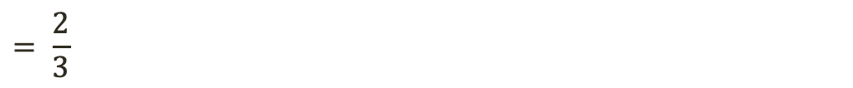
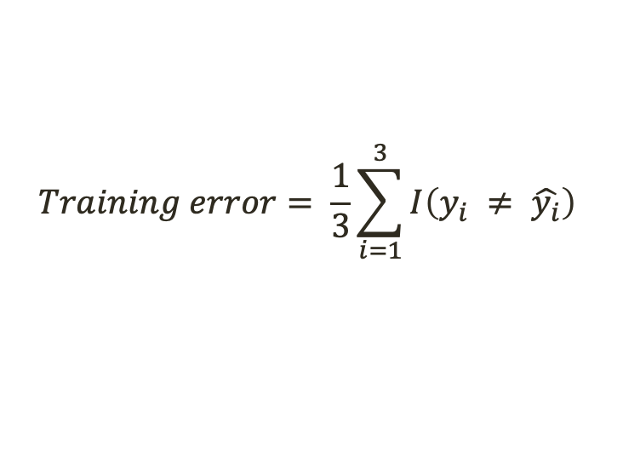

Training error rate
Common approach: measure the proportion of the times our model incorrectly classifies a training data point
and take the
average
tally up
all the times
where the model’s
classification was different
from the true class
n = 3
$$Training error= \frac{1}{3}\sum_{i=1}^{3}{{I\left(y_{i} ≠ \hat{y_{i}}\right)}^{}}$$
Student | Grade
Ab | B- | C+
Kaden | B | B
Kylee | A | D
C$\left(X\right)$
$= \frac{1}{3} ({\left(1\right)}^{}$ + ${\left(0\right)}^{}$ + ${\left(1\right)}^{}$)
$$= \frac{2}{3}$$
$$=0.67$$

Slide 23
Takeaways
Choosing the “right” level of flexibility is critical (in both regression and classification)
Bias-variance trade off makes this challenging
Coming up in Ch. 5:
Various methods for estimating test error rates
How to use these estimates to find the optimal level of flexibility

Slide 24
Code Distribution

Slide 25
GitHub
We will use GitHub to distribute code, collect finished code, and facilitate pair programming
Create a GitHub account (https://github.com/)
Download GitHub Desktop
Notes:
Tour of spyder

Slide 26
GitHub
We will use GitHub to distribute code, collect finished code, and facilitate pair programming
Create a GitHub account (https://github.com/)
Download GitHub Desktop
Demo!
Notes:
Tour of spyder

Slide 27
GitHub
We will use GitHub to distribute code, collect finished code, and facilitate pair programming
Create a GitHub account (https://github.com/)
Download GitHub Desktop
Practice accepting the in-class activity for today, modifying it, and updating your repository
Notes:
Tour of spyder

